Slide 1
Big Data Analytics
Lecture 01 (BSDS_2)
Topic: Fundamentals of Big Data
Dr. Daphne Nyachaki Bitalo
Department of Computing & Technology
Faculty of Engineering, Design & Technology

Slide 2

COURSE OVERVIEW
Big Data
Fundamentals and Mining
Data Analytics
Architectures, storage of data
Data Mining Techniques
Descriptive analytics
Predictive analytics
Notes:
Limited empirical investigation into the challenges encountered by Master's degree students
during the dissertation writing process contributes to difficulties in completing dissertations, resulting in elevated dropout rates and delayed program completion. This study seeks to fill this research gap by examining the specific challenges and solutions.

Slide 3
COURSE OVERVIEW
Semester-based module
2 hours of lectures per week
2 hours in-person practicals
R packages
Assessment via coursework and exams
Coursework contributes 60% to final grade
Exam contributes 40% to final grade
Recommended literature: See course outline on Moodle

Slide 4
Lecture Objectives and Learning outcomes
The Objectives of this lecture are :
Understand the characteristics, challenges, and opportunities of big data
Learn about the big data architectures
Learn about big data storage and management.
Understand the principles of data pre-processing.
By the end of this lecture, students should be able to:
Have an understanding of the applications of big data.
Use python libraries to manage and pre-process big data.

Slide 5
Lecture Overview
Introduction to Big Data
Big Data architectures
Data storage and management
Data pre-processing
Hands-on practical

Slide 6

What is Data?
Data can be defined as any piece of facts that can be collected, analyzed, and interpreted.
It can come in many different forms, such as text, numbers, images, audio, and video.
For example, the number of hours spent studying for an exam, the temperature outside, or the number of likes on a social media .

Slide 7
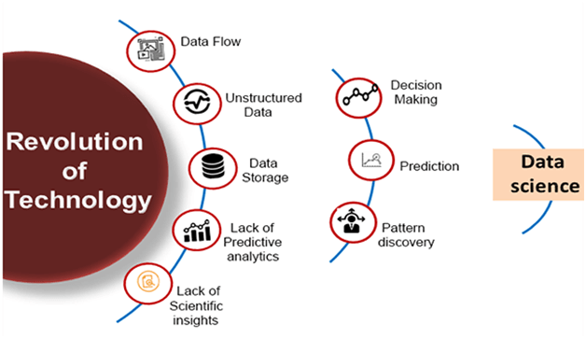
Need for Data Science

Slide 8
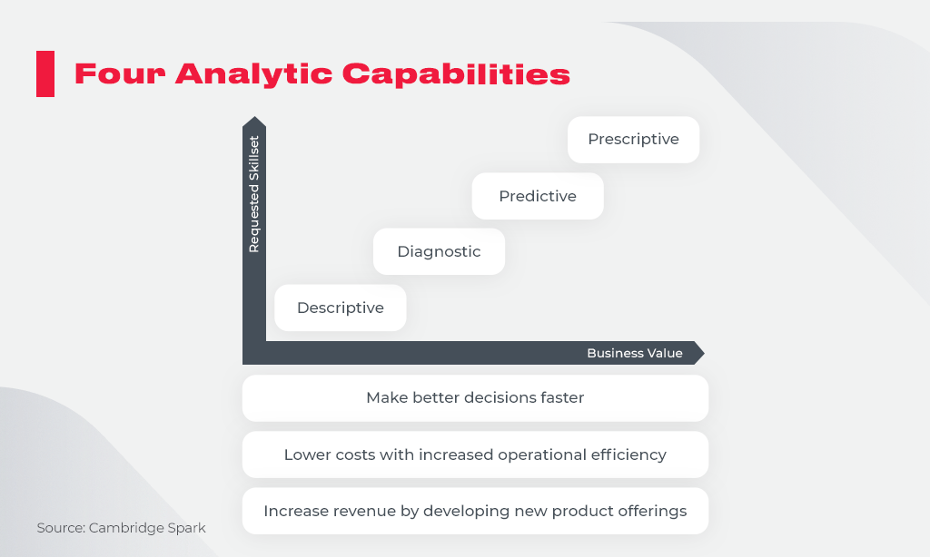
Need for Data Science

Slide 9
Introduction to Big Data
Big Data can bring “big values” to our life in almost every aspect.
Technologically, Big Data is bringing about changes in our lives because it allows diverse and heterogeneous data to be fully integrated and analyzed to help us make decisions.
Today, with the Big Data technology, thousands of data from seemingly unrelated areas can help support important decisions. This is the power of Big Data.

Slide 10
Introduction to Big Data
Areas of Applications
Health and Wellbeing
Policy making and public opinions
Smart cities and more efficient society
New online educational models: MOOC and Student-Teacher modeling
Robotics and human-robot interaction
Much of this power hinges on Research on Analytics

Slide 11
Introduction to Big Data
Big Data refers to extremely large datasets that are difficult to process using traditional data processing applications and tools. These datasets are characterized by their volume, velocity, variety and veracity.
Volume: The sheer amount of data generated is massive.
Velocity: Data is generated at a high speed, often in real-time.
Variety: Data comes in various formats, including structured and unstructured data.
Veracity: Quality and robustness of data

Slide 12
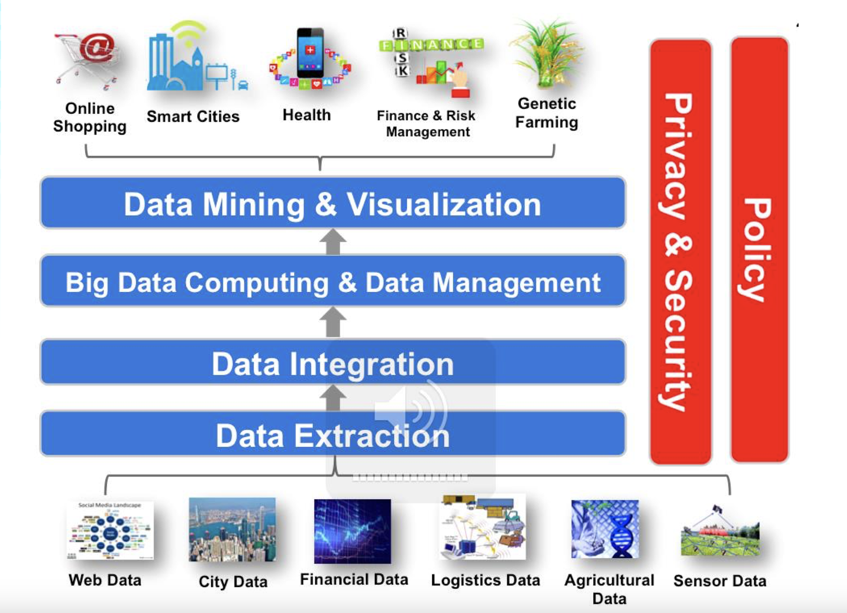
Objectives of Big Data

Slide 13
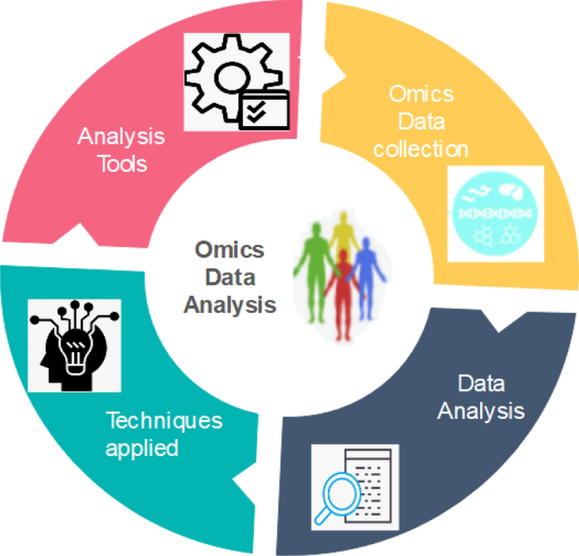
Objectives of Big Data
Big Data Analytics: data mining, visualisation and machine learning
Big Data Computing: data center support for Analytics
Big data collection and transformation, integration and distributed
data management and computing

Slide 14
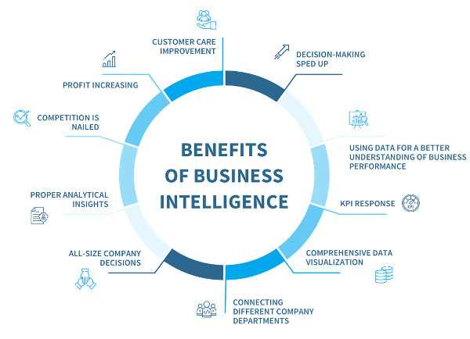
Objectives of Big Data
Big Data Theory, Privacy & Security issues on Analytics
Big data sampling and statistical theory, Big data security and privacy
Big Data Science: 4th Paradigm – Analytics for Science and Engineering
Big Data and Multi-disciplines (Bio, Chemistry, Engineering, Social, Business)

Slide 15
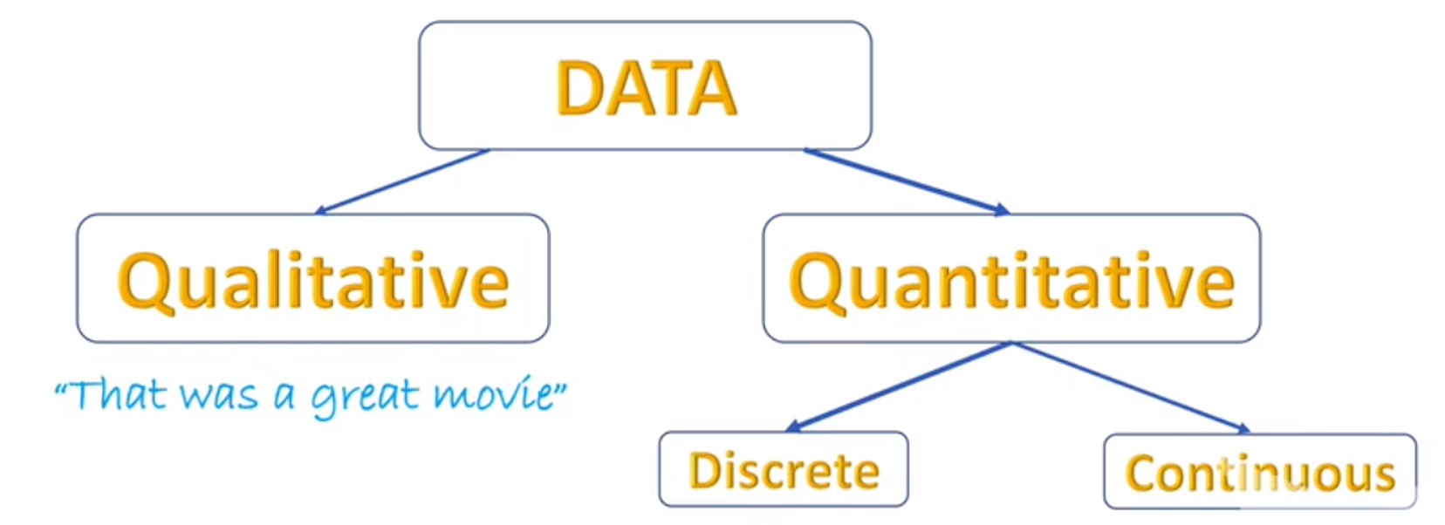
Types of Data

Slide 16
Two major categories of Data
1.QUALITATIVE DATA (Non-Numerical): This is data that is descriptive in nature ie texts and is non numerical in nature. It is collected through surveys, questionnaires, interviews or observations, your social media posts.

Slide 17
Two major categories of Data
2. QUANTITATIVE DATA (Numerical)
Consists of;
i)Discrete: Takes on values that are typically whole numbers. For example; Number of people who visit a website each week, Total amount of transactions processed in a day.
ii)Continuous: This is a type of numerical data that can take any value within a certain range, often with infinite possibilities for example; i)Average distance travelled by a moving car by which is constantly updated as the car continues to move.ii) Temperature measures as these keep varying according to the time.ii) Height measures of an individual

Slide 18
Other types of Data
All pieces of data that are collected have a feature or characteristic known as a data type that helps to identify the data whether it is a character, integer which is helpful in analytics.
The different Data types.
i)String: String data is treated as text composed of letters and numbers for example room number "room 22".
ii)Integer: Consists of whole numbers or numbers that do not include decimals or fractions. For example 0, 1, 2, 3

Slide 19
Other types of Data
iii) Floating point: Consists of numbers with decimals ie 1.2, 0.0003, -4.56
iv) Date and time: Stores an instant time that is expressed as a calendar date and time in the formats of 2001-03-15, YYYY-MM-DD, h:mm:s, 2001-03-15 11:24:09
v) Bolean: Data is treated as true or false and can be represented as "yes" or "1" (for true) and "No" or "0" ( for false). For example; 12 is greater than 10 = true. For example; Assume we have a database where we store employee details and a particular user Paul is not a manager this will eventually mean that; " Paul is not a manager=yes".

Slide 20
Structured Data
In order to process, store, and analyze all of these different types of data, it is important to think about whether they are structured data or unstructured data.
STRUCTURED DATA: Makes up about 10%-20% of generated data and has clearly defined data types and patterns that make them easily stored and organized into columns and rows. This organization makes structured data easy to search and analyze.
Sources of structured data include sales records, airline reservation systems, and inventory control. Structured data is usually stored in relational databases such as Structured Query Language (SQL) databases or in spreadsheets such as Microsoft Excel.

Slide 21
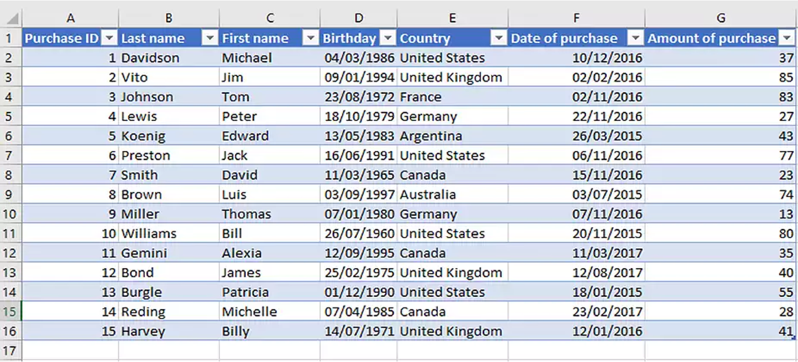
Structured Data

Slide 22
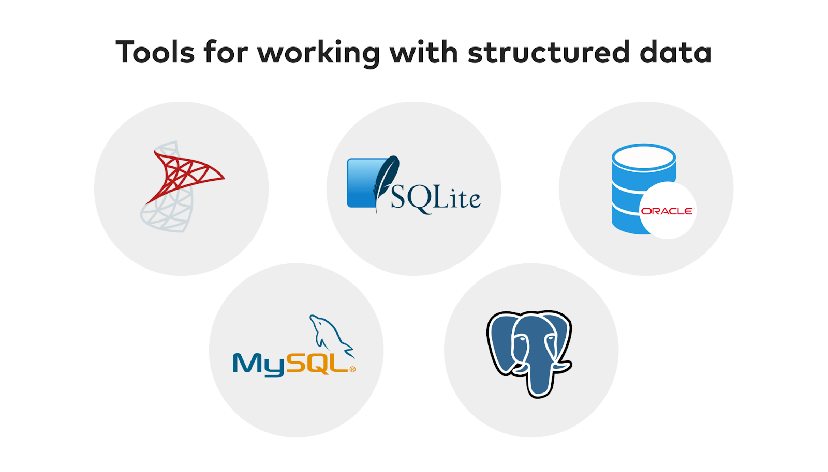
Structured data tools

Slide 23
Unstructured Data
UNSTRUCTURED DATA: Makes up most data that is generated, about 80%, and cannot be organized into row and columns. This makes unstructured data difficult to search, manage, and analyze.
Sources of unstructured data include images, PDFs, sensor data, and social media posts. Unstructured data is usually stored in a non-relational database also known as NoSQL Database.

Slide 24
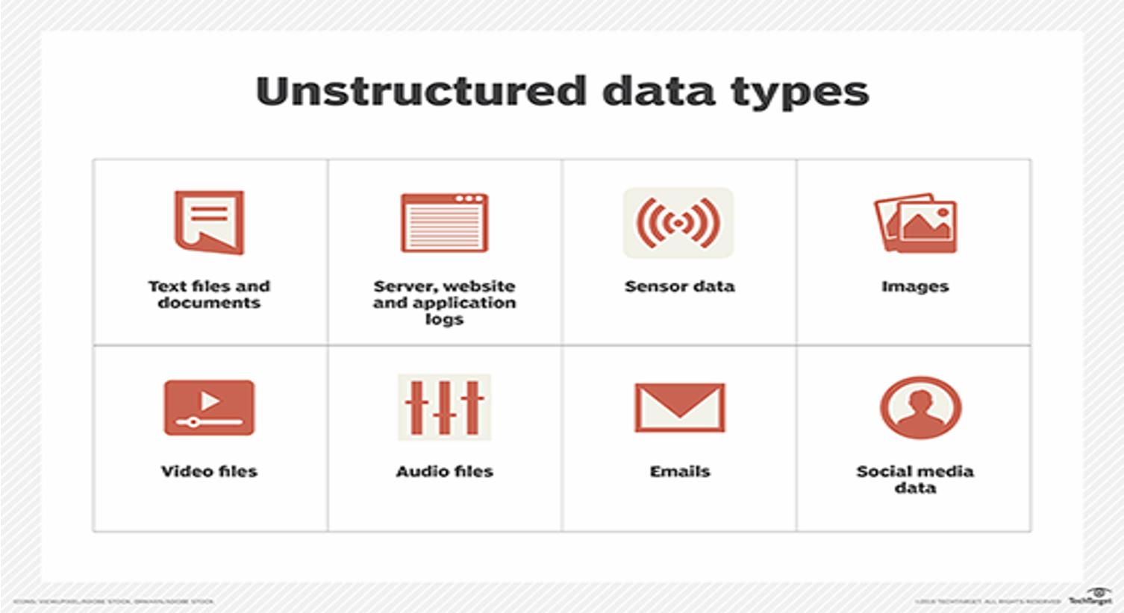
Unstructured Data

Slide 25

Unstructured Data

Slide 26
Human-generated unstructured data
A collection of social media posts about a popular TV show, with varying formats and no clear structure.
•"OMG just finished the finale of the show and I am SHOOK! 😱 #mindblown #bestshowever"
•"Finally got around to watching the show and it did not disappoint! Already looking forward to the next season #bingewatching"
•"I don't get the hype around this show, I thought it was boring and predictable 🤷‍♀️ #unpopularopinion"
•"Just finished the show and now I don't know what to do with my life 😭 #postshowdepression"

Slide 27
Human-generated unstructured data
Websites: YouTube, Instagram etc
Mobile data: text messages, locations.
Communications: IMs, dictaphone recordings.
Media: MP3, digital photos, audio recordings and video files.
Business applications: MS Office documents, PDFs and similar.

Slide 28
Semi-structured Data
Contains both structured and unstructured data.
We can see semi-structured data as a structured in form but it is actually not defined with e.g. a table definition in a database management system (DBMS).
Example of semi-structured data is a data represented in an XML file.
Personal data stored in an XML file-
<rec><name>Prashant Rao</name><sex>Male</sex><age>35</age></rec>
<rec><name>Seema R.</name><sex>Female</sex><age>41</age></rec>
<rec><name>Satish Mane</name><sex>Male</sex><age>29</age></rec>
<rec><name>Subrato Roy</name><sex>Male</sex><age>26</age></rec>

Slide 29
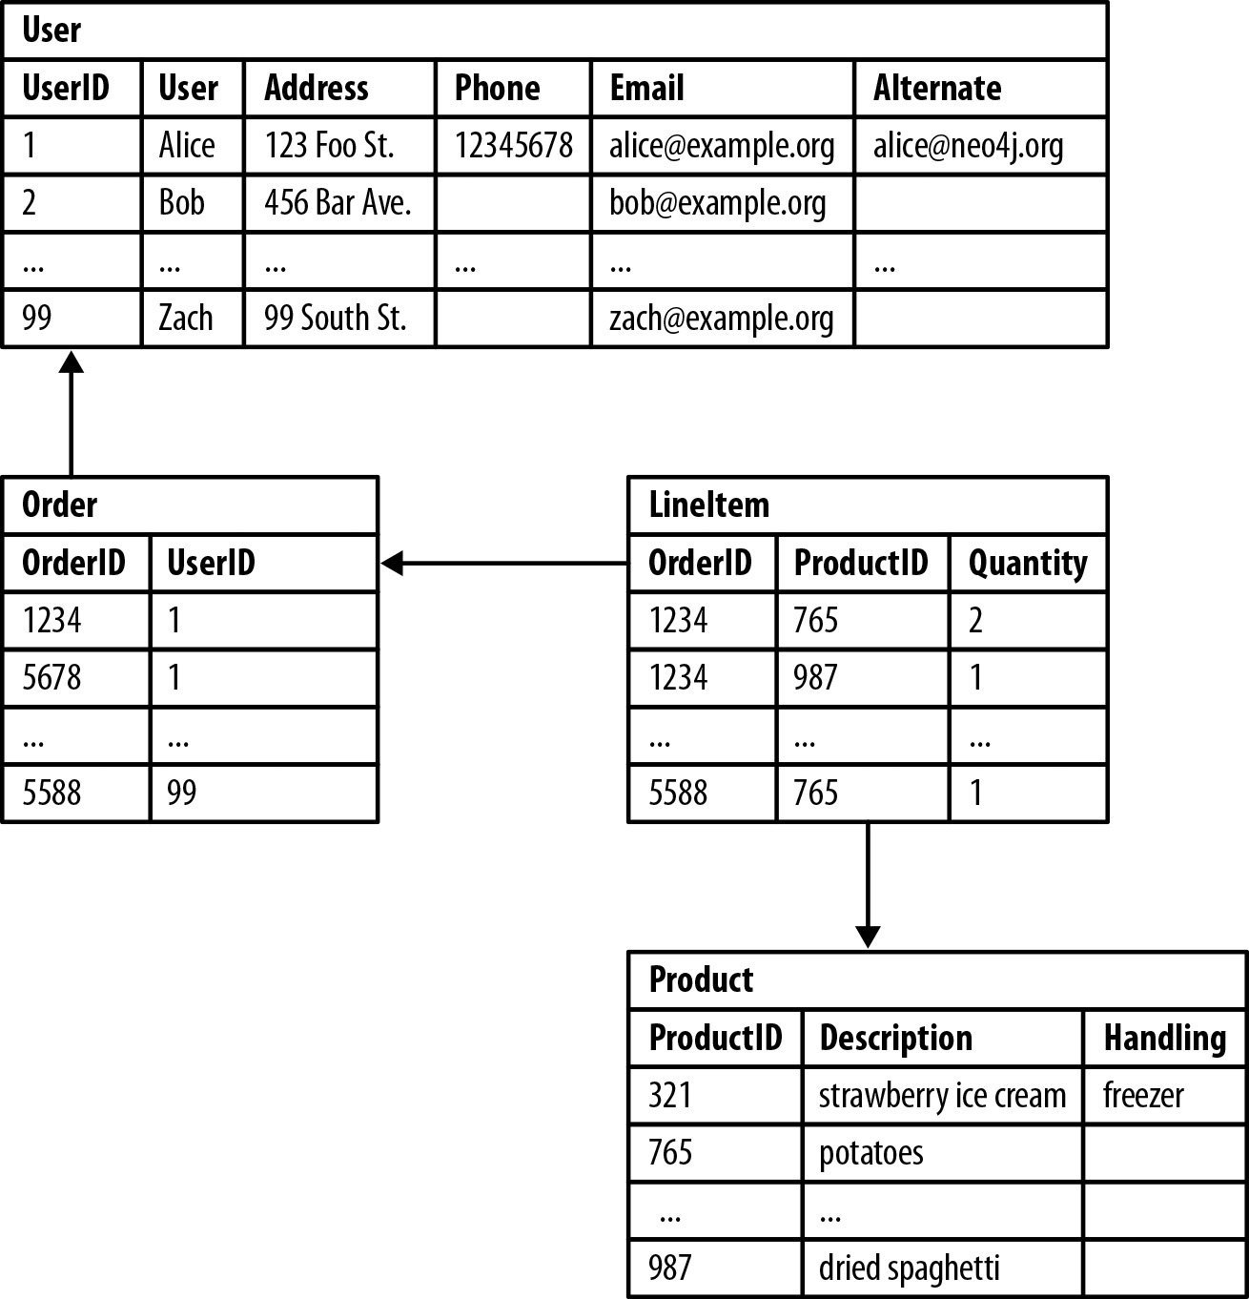
Example of a Relational Database
From the top-down, we can see that UserID 1 refers to the customer Alice, who had two Order IDs of ‘1234’ and ‘5678’.
Next, Alice had two ProductIDs of '765’ and ‘987’.
Finally, we can see Alice purchased two packages of potatoes and one package of dried spaghetti.

Slide 30
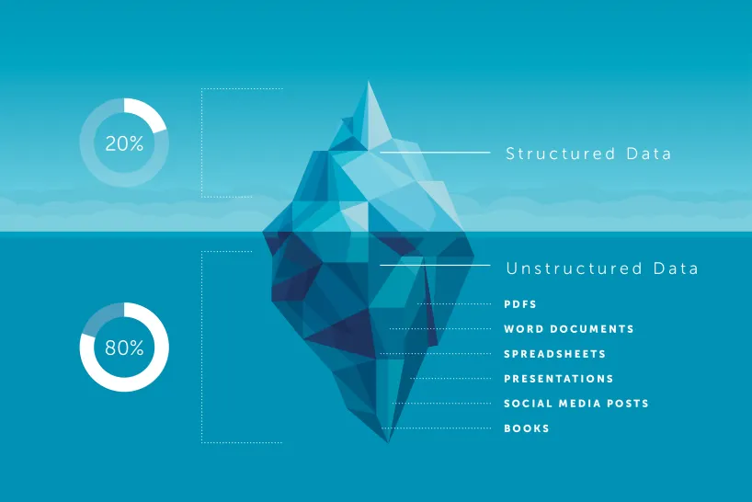
Structured Data vs. Unstructured Data

Slide 31
Challenges of Big Data
Storage: Storing massive amounts of data requires efficient and scalable storage solutions.
Processing: Processing large datasets can be computationally intensive and time-consuming.
Analysis: Extracting meaningful insights from big data requires advanced analytics techniques/skills.
Integration: Integrating data from multiple sources can be challenging due to inconsistencies and varying formats.
Security: Protecting sensitive data from unauthorized access is a major concern

Slide 32
Tools for Big Data
Hadoop: A distributed computing framework for processing large datasets.
Spark: A fast and general-purpose cluster computing system.
NoSQL Databases: Databases designed to handle large-scale, unstructured data.
Cloud Computing: Utilizing cloud-based infrastructure to store, process, and analyze big data.

Slide 33
Big Data architectures
Hadoop
Distributed File System (HDFS): Hadoop's core component, providing a scalable and fault-tolerant distributed file system.
MapReduce: A programming model for processing large datasets in parallel across a cluster of computers.
YARN: A resource management system that allocates resources to applications running on the Hadoop cluster.
Use Cases:
Batch processing of large datasets
Data warehousing and analytics
ETL (Extract, Transform, Load) processes

Slide 34
Big Data architectures
Spark
In-Memory Processing: Spark processes data in memory, which can significantly improve performance compared to disk-based processing.
Unified Architecture: Spark provides a unified architecture for batch processing, streaming, and machine learning workloads.
Rich Ecosystem: Spark has a rich ecosystem of libraries and frameworks for various data processing tasks.
Use Cases:
Real-time data processing
Machine learning and artificial intelligence
Interactive data analysis

Slide 35
Big Data architectures
NoSQL Databases
Key-Value Stores: Store data as key-value pairs, high performance for simple data access.
Document Stores: Store data as documents, suitable for semi-structured and unstructured data.
Wide-Column Stores: Store data as columns,
Graph Databases: Store data as nodes and relationships, making them ideal for graph-based analysis.
Use Cases:
Real-time applications
Content management systems
Social networking platforms
Recommendation systems

Slide 36
Big Data Pre-processing
Data preprocessing is a crucial step in the data science pipeline, involving various techniques to prepare raw data for analysis. It ensures data quality, consistency, and suitability for modeling.
It involves Cleaning, Integration, Transformation, and Reduction

Slide 37
Big Data pre-processing
Cleaning
Handling missing values: Imputation techniques (mean, median, mode, regression, etc.) or deletion.
Dealing with outliers: Identification (statistical methods, visualization) and removal or correction.
Noise reduction: Smoothing techniques (e.g., moving average) to remove noise or inconsistencies.
Data correction: Identifying and correcting errors or inconsistencies in the data.

Slide 38
Big Data pre-processing
Integration
Merging datasets: Combining multiple datasets based on common keys or identifiers.
Data standardization: Ensuring consistency in data formats, units, and encoding.
Entity resolution: Identifying and merging duplicate records representing the same entity.
Key for descriptive and predictive analysis

Slide 39
Big Data pre-processing
Transformation
Normalization: Scaling data to a specific range (e.g., 0-1) to improve model performance (e.g. converting categorical data).
Feature engineering: Creating new features from existing ones to capture relevant information.
Aggregation: Combining multiple data points into a single value (e.g., calculating averages or sums).
Discretization: Converting continuous data into discrete categories.

Slide 40
Big Data pre-processing
Reduction
Dimensionality reduction: Reducing the number of features while preserving essential information.
Feature selection: Choosing the most relevant features for analysis.
Sampling: Selecting a subset of data for analysis to reduce processing time.
Key for predictive analysis

Slide 41
Data pre-processing using R
PRACTICUM USING R and R-STUDIO
Generate a dataset in excel with 8 variables/columns and call it Student_performance.xlsx
(Access_no, gender, age, course, DSC3108, DSC3114, MTH3108, SYE3104)
Populate the rows with data that you will use in the practical

Slide 42


Data management

Slide 43
Understanding big data management
Qn. Describe data flow through pipelines
The data pipeline starts with data being extracted, transformed and loaded for storage either on cloud or on-premises storage.
Data flows through the three phases of a data pipeline; ingestion(Extract), transformation and storage(load).

Slide 44
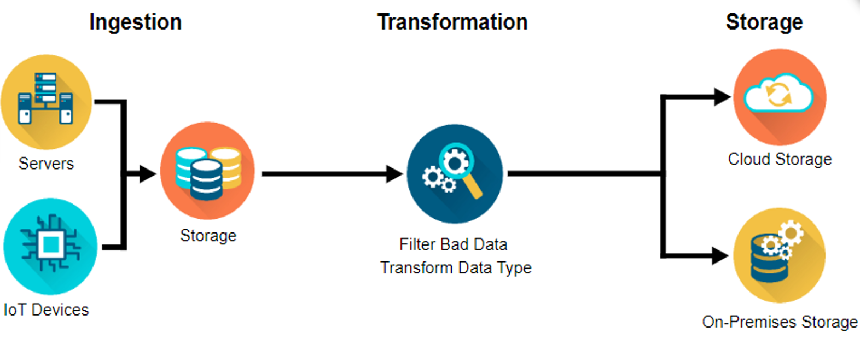
Understanding big data management

Slide 45
Ingestion (Extraction)
Data engineers ingest two primary sources of data;
1. Batches of data from servers or databases (batch ingestion).
An example of batch ingestion is a game company that wants to examine the relationship between subscription renewals and customer support tickets. It could ingest all the related data on a daily or weekly basis. It doesn’t need to access and analyze data immediately after a support ticket is closed or a subscription is renewed.

Slide 46
Ingestion (Extraction)
2. Real-time events happening in the world and streaming from the world of devices (streaming ingestion).
An example of streaming ingestion is when you request a ride from a ride share service. The company combines streams of data (e.g. historical data, real-time traffic data, and location tracking) to make sure you get a ride from the driver who is closest to you at the time.

Slide 47
Transformation
There are two main issues to deal with here;
Data often needs to be cleaned up.
Missing values, dates can be in the wrong format and data quickly gets outdated.
You might have gathered data on individuals who have changed roles or companies. So, all this data needs to be updated.
There might be data outliers that need to be handled as well

Slide 48
Transformation
2. Transforming the data so that its structure aligns with the system needed to allow accurate analyses.
For example;
You might want to figure out your company’s best selling products every month. But the data may only contain each product’s sale date. You would need to transform the data by creating a number of sales per month variable or total monthly sales.

Slide 49
Loading
After transforming data, it needs to be stored in places and forms, making it easy for analysts to run reports on weekly sales and data scientists to deduce insights and create predictive recommendation models.
Data security, or managing data access so that people who should be accessing the data can efficiently, and keeping out people who shouldn’t.
There are two primary locations for businesses to store their data;
1. On-premises
2. In the cloud but often, companies use a hybrid of both.
The term “on-premises” refers to hardware on an organization’s servers and infrastructure - usually physically on site.

Slide 50
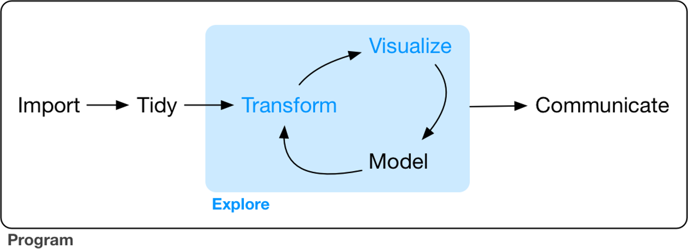
Steps of data exploration
Data exploration is the art of looking at your data, rapidly generating hypotheses, quickly testing them, then repeating again and again and again.

Slide 51
Exploratory Data Analysis (EDA)
An interactive cycle;
1. Generates questions about your data.
2. Searches for answers by visualizing, transforming, and modeling your data.
3. Uses what you learn to refine your questions and/or generate new questions.
There is no rule about which questions you should ask to guide your research.
However, two types of questions will always be useful for making discoveries within your data. You can loosely word these questions as:
1. What type of variation occurs within my variables? (i.e. variability)
2. What type of covariation occurs between my variables? (i.e. central tendency)
All of the above questions generate DESCRIPTIVE and NOT predictive analyses

Slide 52
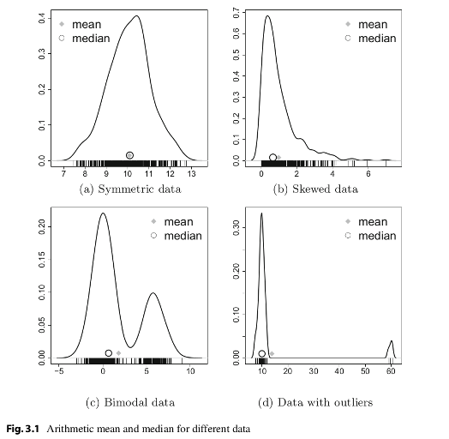
Central tendency
Central tendency is a measure that best summarizes the data and is a measure that is related to the center of the data set.
Described by the statistics Mode, Median and Mean

Slide 53
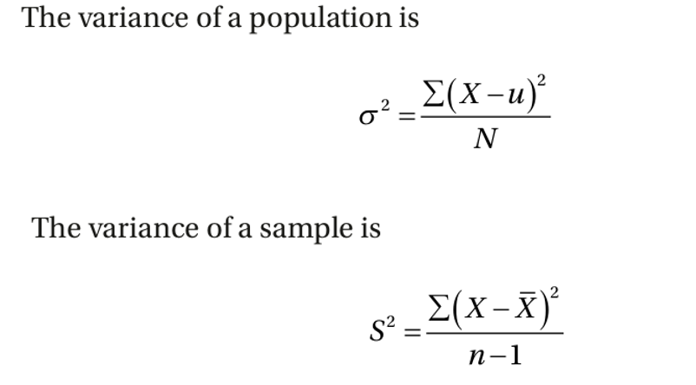
Variability
Measures of variability are the measures of the spread/dispersion of the data.
Described by range, interquartile range, variance, standard deviation, and more
Variance is one of the most important measures in statistics
Covariation- two or more variables vary in a related manner. The best way to discover covariation is to visualize the relation.

Slide 54
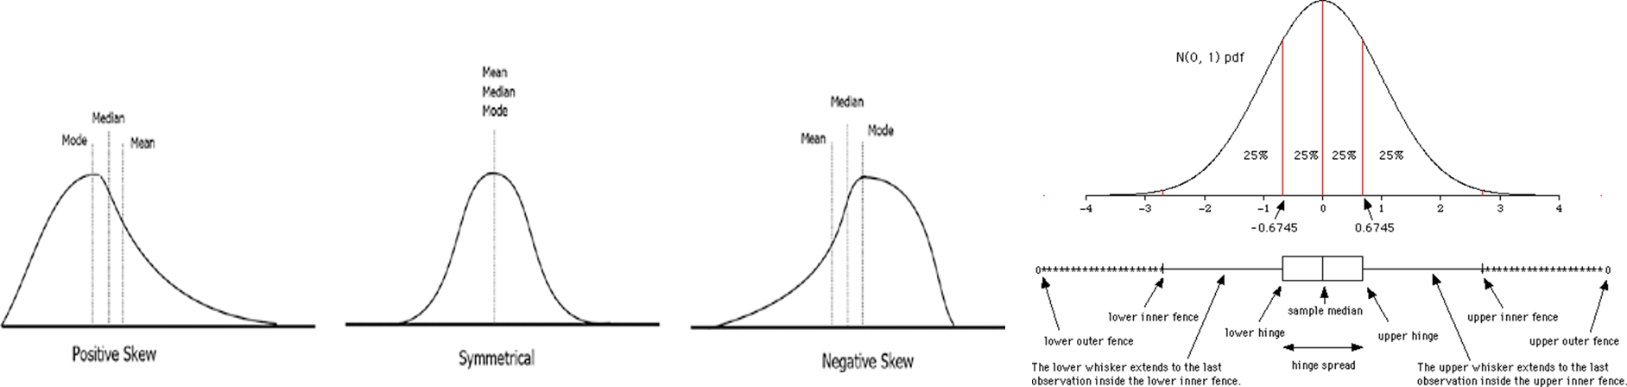
Defining the descriptive statistics
1. Measure of central tendency: mean, median, mode
Measures the “average” or the “middle” of your data. The most commonly used measures include:
•the mean: the average value. It’s sensitive to outliers.
•the median: the middle value. It’s a robust alternative to mean.
•and the mode: the most frequent value

Slide 55
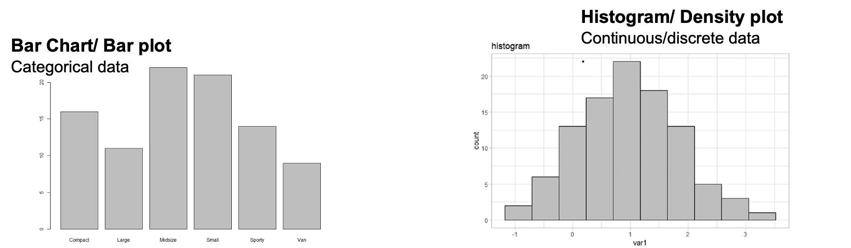
Defining the descriptive statistics
2. Measure of variability
Measures of variability gives how “spread out” the data are.
•Range: minimum & maximum
•Range corresponds to biggest value minus the smallest value. It gives you the full spread of the data.

Slide 56
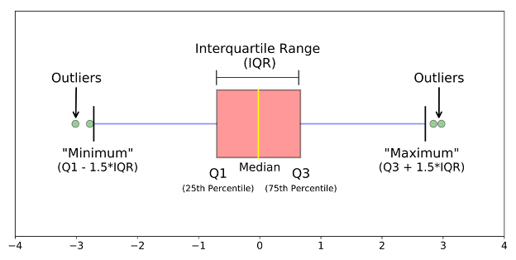
Defining the descriptive statistics
3. Interquartile Range (IQR)
Quartiles divide the data into 4 parts. IQR corresponds to the difference between the first and third quartiles - is sometimes used as a robust alternative to the standard deviation.

Slide 57
Purpose of each descriptive statistic
1. Range. It’s not often used because it’s very sensitive to outliers.
2. IQR. It’s pretty robust to outliers.
3. Variance. It’s completely uninterpretable because it doesn’t use the same units as the data. It’s almost never used
4. Standard deviation. This is the square root of the variance. It’s expressed in the same units as the data. The standard deviation is often used in the situation where the mean is the measure of central tendency.
5. Median. It’s a robust way to impute for missing data, for data with outliers. Used with continuous data that is not normally distributed.
6. Mode. Imputes for missing data that is categorical
7. Mean. Imputes for missing continuous data that is normally distributed

Slide 58
Testing for normal distribution
Rule of thumb:
Many of the statistical tests including correlation, regression, t-test, and analysis of variance (ANOVA) assume some certain characteristics about the data. They require the data to follow a normal distribution or Gaussian distribution. These tests are called parametric tests, because their validity depends on the distribution of the data.

Slide 59
Testing for normal distribution
So the distribution of data has to be testing using the following:
1. Visual inspection [normal plots (histogram), Q-Q plot (quantile-quantile plot)], boxplots)
2. Significance tests. Such as Shapiro-Wilk’s test (samples >3< 5000) and Kolmogorov-Smirnov (K-S) test (samples > 5000)
Data distribution also informs how missing data is handled

Slide 60
Practicum using R
1. Import the provided datasets in to visual studio (“Cassava_Yield_Data.xlsx” and “Bike_Sales.xlsx”)
2. Explore the datasets by identifying the data type of each variable.
3. Which variables are observations and which are samples?
4. Which variables are populations? (This will be guided by the questions you pose)
5. Transform both datasets to handle missing data.
6. Save the transformed datasets as .csv files with your last name.
7. Using the above saved datasets, describe the central tendency of two continuous variables.
8. Generate graphs to show the variability on one continuous variable and one categorical variable.

